Slide 1
PHP Functions and Control Structures

Slide 2
Credits
Some of the contents of this slide presentation have been referenced and reproduced from the textbook for this course, PHP Programming with MySQL (Second Edition) , Don Gosseling, Diana Kokoska, and Robert Easterbrooks, ©2011, Cengage Learning, All Rights Reserved. ISBN 978-0-5387-4584-0.
Thank you for some references to Kevin Skoglund, from PHP with MySQL Essential Training (2013), ©2017 LinkedIn Corporation.

Slide 3
LEARNING OBJECTIVES
Discover functions to organize PHP code
Examine variable scope
Contrast conditional statements if, if...else, and switch
Compare iteration statements, while, do...while, for, and foreach
Analyze include and require statements

Slide 4
Working with Functions
Overview
Functions are groups of statements that execute as a single unit
Usually designed to perform a specific task
Can be called upon whenever that task is needed
The program may provide data to functions
Functions my return data back to the program
Functions may be built-in, or provided by the language API
The programmer may define custom functions

Slide 5
Working with Functions
Function Definitions
Syntax function funcName(parameters){ statements; }
The keyword function, the name, and the parameter list are known as the function signature
Function names follow the same rules as identifiers
They do not start with a dollar sign ( $ )
However, they are case insensitive
The set of curly braces delimits a code block
Contain the executable function statements

Slide 6
Working with Functions
Function Definitions
function funcName(parameters)
Parameters
Called formal parameters in the definition
Placed within parentheses following the function name
Functions do not have to contain parameters
Variables that contain values passed to a function when it is called
The values passed on the function call are called arguments

Slide 7
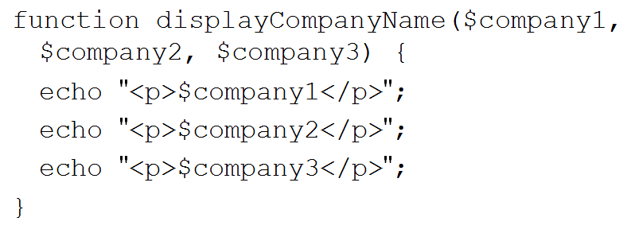
Working with Functions
Function Definitions

Slide 8
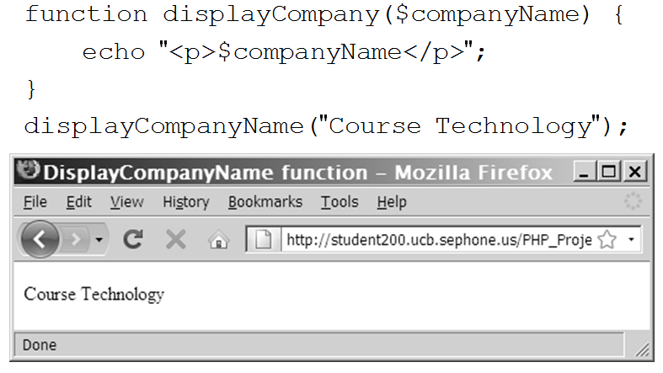
Working with Functions
Calling Functions

Slide 9
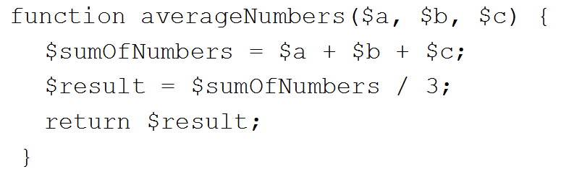
Working with Functions
Returning Values
A return statement returns a value to the statement that called the function
Not all functions return values
Return statement immediately exits the function
Return multiple values by returning them in an array

Slide 10
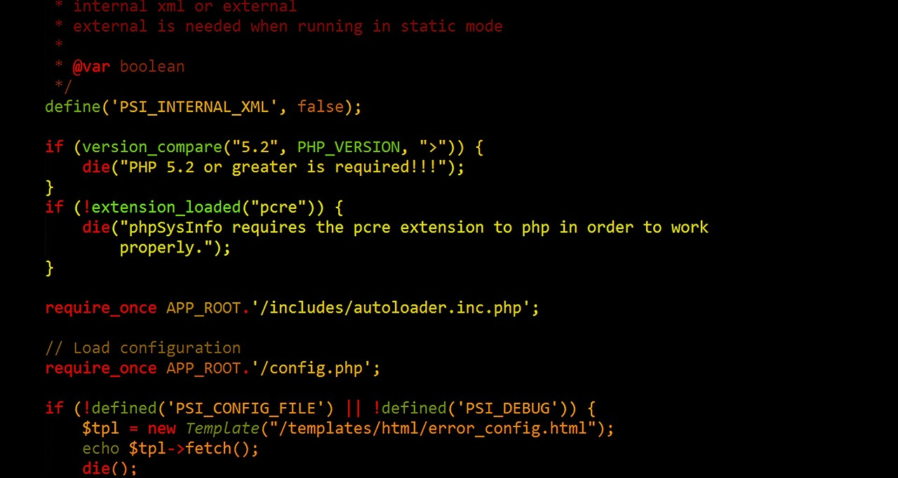
Working with Functions
Programming Exercise 02_02_01 – Step 1
Using Functions

Slide 11
Working with Functions
Passing Parameters
A function parameter can be passed by value or by reference
A function parameter that is passed by value is a local copy of the variable
The original is not changed outside the function
A function parameter that is passed by reference is a reference to the original variable
The original is changed outside the function
Use an ampersand ( & ) before the $ to pass by reference &$companyName = $newName;

Slide 12
Working with Functions
Default Parameters
A function parameter can be given a default function paint($room=”office”, $color=”red”)
The following will work as expected: $paint(); $paint(”bedroom”, ”blue”); $paint(”bedroom”, null); $paint(”bedroom”);
The following will not work as expected $paint(”blue”);
The defaults must be after the required parameters

Slide 13
Working with Functions
Programming Exercise 02_02_01 – Step 2
Passing Parameters

Slide 14
Examine Variable Scope
Variable Scope
Exactly where in a program a declared variable can be seen or used
A variable’s scope can be either global or local
A global variable is one that is declared outside a function and is available to all parts of a program
A local variable is declared inside a function and is only available within that function

Slide 15
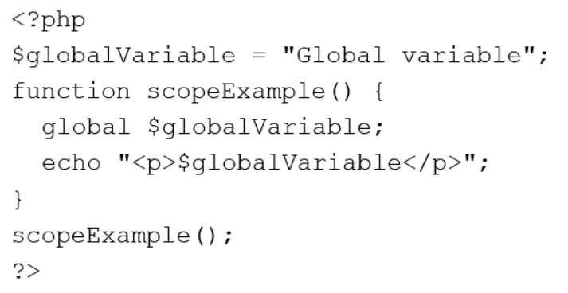
Examine Variable Scope
The global Keyword
A global variable must be declared with the global keyword inside a function
Makes the variable available within the scope of that function

Slide 16
Examine Variable Scope
Programming Exercise 02_02_01 – Step 3
Variable Scope

Slide 17
Conditional Statements
Flow of Control
Refers to the order in which, or if, the individual statements of a program are executed or evaluated
Purpose is to take execution out of a directly sequential path
Regulates the non-sequential steps
All possible algorithms can be expressed in terms of just three simple logic structures
Sequence
Decision
Loop

Slide 18
Conditional Statements
Flow of Control Constructs
Conditional: selection, decisions, branching
if...else construct
switch construct
Iteration: looping, repetition
while loop
do...while loop
for loop
foreach loop

Slide 19
Conditional Statements
Conditional Expressions
Used to execute specific programming code based on the evaluation of a the expression
Conditional expressions are combinations
Boolean expressions which evaluate to:
True False
Relational or comparison operators
> < >= <= == === != !==
Logical or Boolean operators combine multiple conditions
&& and || or !

Slide 20
Conditional Statements
Conditional Expressions
Conditional expressions are combinations
$age > 65
$answer == ”yes”
$answer === ”yes”
$age > 12 and $age < 65
$age > 12 && $age < 65
$balance < 0 || $overdraft === true

Slide 21
Conditional Statements
if Statements
Used to execute specific programming code based on the evaluation of its conditional expression
Syntax
if (conditional expression){ statements; }
Contains three parts:
Keyword if
A conditional expression enclosed within parentheses
The executable statements in a code block delimited with curly braces ( { } )

Slide 22
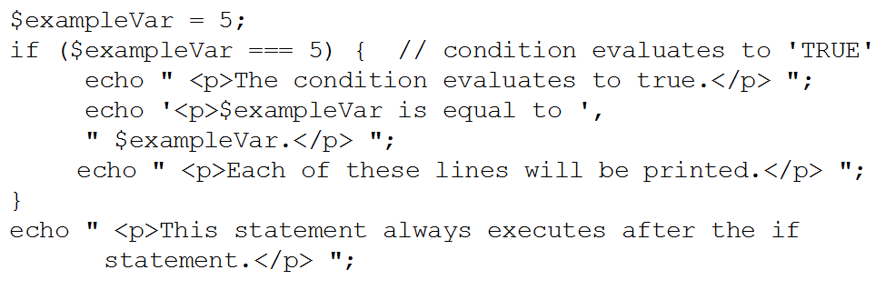
Conditional Statements
if Statements

Slide 23
Conditional Statements
Programming Exercise 02_02_01 – Step 4
if Statements

Slide 24
Conditional Statements
if…else Statements
An if statement that includes an else clause
An else clause executes when the condition in an if...else statement evaluates to false
Syntax
if (conditional expression){ statements; } else { statements; }

Slide 25
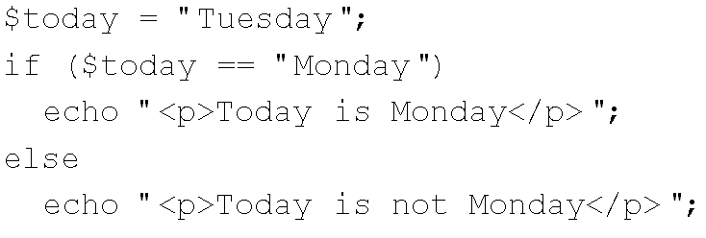
Conditional Statements
if…else Statements
An if statement can be constructed without the else clause
The else clause can only be used with an if statement

Slide 26
Conditional Statements
Programming Exercise 02_02_01 – Step 5
if…else Statements

Slide 27
Conditional Statements
else if and elseif Statements
Used to construct sequential if...else statements
if (conditional expression){ statements; } else if (conditional expression){ statements; }
elseif (conditional expression){ statements; } else { statements; }

Slide 28
Conditional Statements
Programming Exercise 02_02_01 – Step 6
else if and elseif Statements

Slide 29
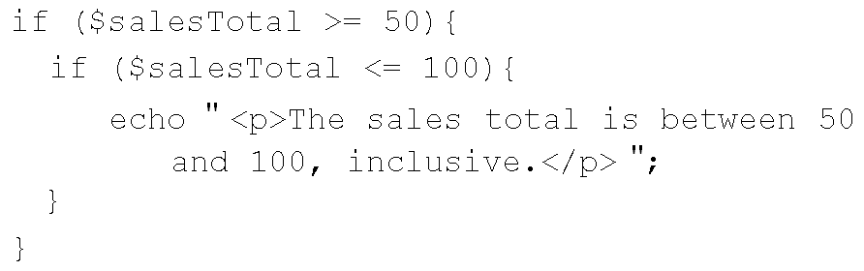
Conditional Statements
Nested if Statements
When one decision-making statement is contained within another decision-making statement

Slide 30
Conditional Statements
Programming Exercise 02_02_01 – Step 7
Nested if Statements

Slide 31
Conditional Statements
switch Statements
Control program flow by executing a specific set of statements depending on the value of an expression
Compare the expression value to a value contained within a statement called a case label
A case label is followed by one or more statements that execute if the value matches

Slide 32
Conditional Statements
switch Statements
A case label consists of:
The keyword case
A literal value or variable name
A colon ( : )
A case label can be followed by a single statement or multiple statements
case usually followed by optional break statement
Without a break, falls through to next case
Multiple statements for a case label do not need to be enclosed within a code block

Slide 33

Conditional Statements
switch Statements
The default label
Contains statements that execute when the value returned by the switch statement expression does not match a case label
A default label consists of:
The keyword default
Followed by a colon ( : )
Multiple case labels can be used for one set of statements

Slide 34
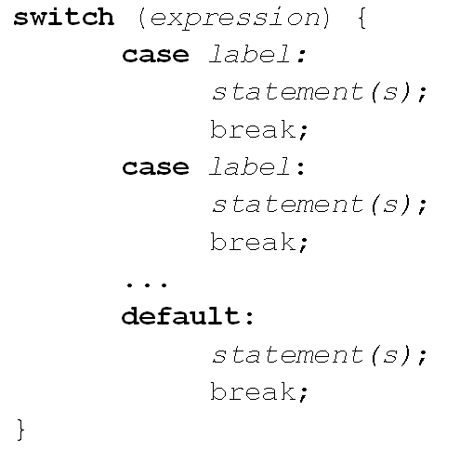
Conditional Statements
switch Statements
Syntax

Slide 35
Conditional Statements
Programming Exercise 02_02_01 – Step 8
switch Statements

Slide 36
Iteration Statements
Iteration or Loops
A loop statement is a control structure that repeatedly executes a code block
Statements execute while a specific condition is true
Or until a specific condition becomes true
Four types of Iteration
while loop
do...while loop
for loop
foreach loop

Slide 37
Iteration Statements
Iteration or Loops
Each repetition of a loop is called an iteration
Whether an iteration occurs is controlled by a sentinel
A sentinel may by condition-controlled
A sentinel may by count-controlled
A loop may be either top-tested or bottom-tested
An infinite loop never ends because its conditional expression never evaluates to false

Slide 38
Iteration Statements
while Loops
Top-tested, tests the condition prior to executing the loop code block
Therefore, not guaranteed to execute
Syntax while (conditional expression){ statements; }
As long as the conditional expression, or sentinel, evaluates to true, the following code block executes repeatedly

Slide 39
Iteration Statements
while Loops
Condition-controlled $number = rand(1,100); while ($number !== 52){ $number = rand(1,100); }

Slide 40
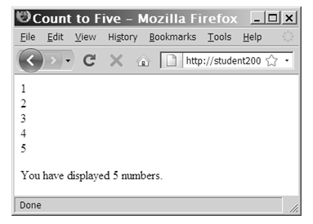
Iteration Statements
while Loops
Count-controlled Increment $count = 1; while ($count <= 5){ echo ”$count<br>”; ++$count; } echo ”<br>You have displayed 5 numbers.”;

Slide 41
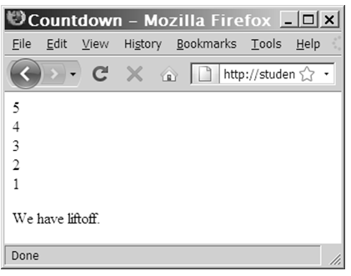
Iteration Statements
while Loops
Count-controlled Decrement $count = 5; while ($count > 0){ echo ”$count<br>”; --$count; } echo ”<p>We have liftoff.</p>”;

Slide 42
Iteration Statements
Programming Exercise 02_02_01 – Step 9
while Loops

Slide 43
Iteration Statements
do…while Loops
Bottom-tested, tests the condition after executing the loop code block
Therefore, guaranteed to execute at least once
Syntax do{ statements; } while (conditional expression);
The following code block executes repeatedly until the conditional expression, or sentinel, evaluates to false

Slide 44
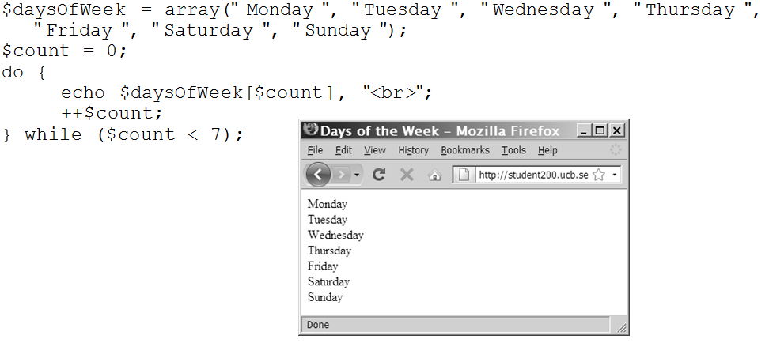
Iteration Statements
do…while Loops

Slide 45
Iteration Statements
Programming Exercise 02_02_01 – Step 10
do…while Loops

Slide 46
Iteration Statements
for Loops
Top-tested
Combines the initialize, conditional expression, and update parts of a loop into a single statement
Syntax for (init; condition test; update) { statements; }
The code block executes until the conditional expression, or sentinel, evaluates to false

Slide 47
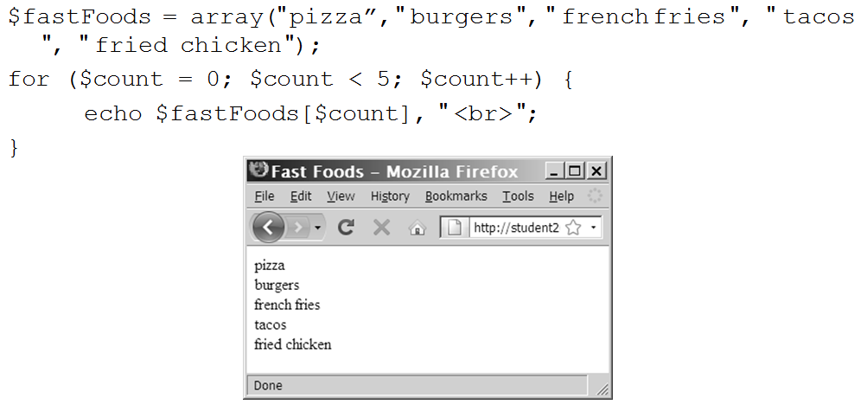
Iteration Statements
for Loops

Slide 48
Iteration Statements
Programming Exercise 02_02_01 – Step 11
for Loops

Slide 49
Iteration Statements
foreach Loops
Used to iterate, or loop, through the elements in an array
Already aware of the structure length: count()
Syntax foreach ($arrayName as $varName) { statements; }
The code block executes through the entire data structure
&$varName uses it by reference

Slide 50
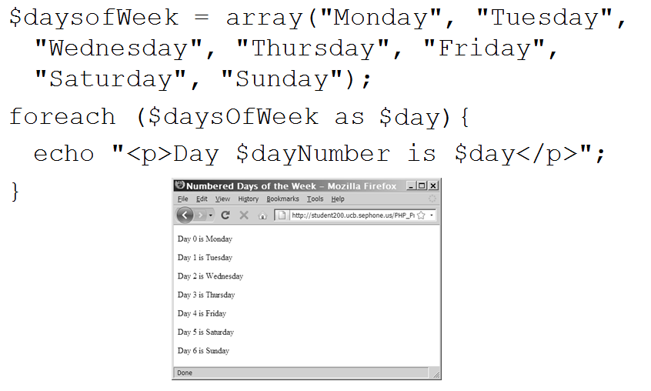
Iteration Statements
foreach Loops

Slide 51
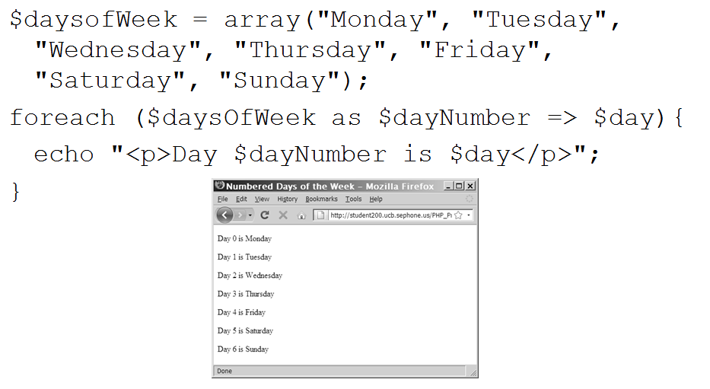
Iteration Statements
foreach Loops – Associative Array Syntax
We will study associative arrays further on

Slide 52
Iteration Statements
break Statement
Causes an exit from anywhere in the body of a loop
When break is executed a loop immediately terminates
break statements usually occur as a result of if statements
if (!$happy) { break; } // rest of loop statements

Slide 53
Iteration Statements
continue Statement
Current iteration of the loop terminates
Execution returns to the loop’s condition statement
continue statements usually occur as a result of if statements
if (!$happy) { continue; } // rest of loop statements

Slide 54
Iteration Statements
Programming Exercise 02_02_01 – Step 12
foreach Loops

Slide 55
include and require Statements
Including External Files
The include, require, include_once, and require_once statements insert the contents of an external file at the location of the statement
The purpose is for maintainability and content reuse
Differences
include statements generate a warning if file not found
require statements halt process of the Web page if file not found

Slide 56
include and require Statements
Including External Files
The _once versions assure that the external file is added to the script only one time
Best Practice is to name include files with the prefix inc_
Syntax
<?php include(“inc_header.php”) ?>
<?php require(“inc_header.php”) ?>

